Slide 1


AWS SOLUTIONS ARCHITECT ASSOCIATE
Module 6:
AWS Identity and Access Management (IAM)

Slide 2
Module Overview
Principals
Authentication
Authorization
Other Key Features

Slide 3

Lesson 01: Principals

Slide 4

Principals
Root User
IAM Users
Roles/Temporary Security Tokens
  Amazon EC2 Roles
  Cross-Account Access
  Federation
IAM

Slide 5
Principals
Principal | Traits
Root User | Cannot be limited Permanent
IAM Users | Access controlled by policy Durable Can be removed by IAM administrator
Roles/Temporary Security Tokens | Access controlled by policy Temporary Expire after specific time interval

Slide 6
Lesson 02: Authentication

Slide 7
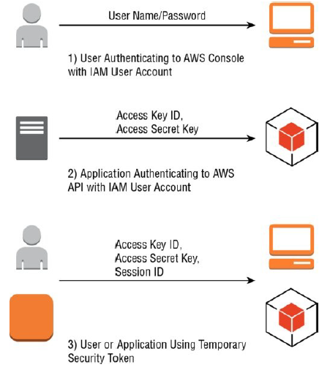
Authentication
User Name/Password
Access Key
Access Key/Session Token

Slide 8
Lesson 03: Authorization

Slide 9
Authorization
Policies
  Effect
  Service
  Resource
  Action
  Condition

Slide 10
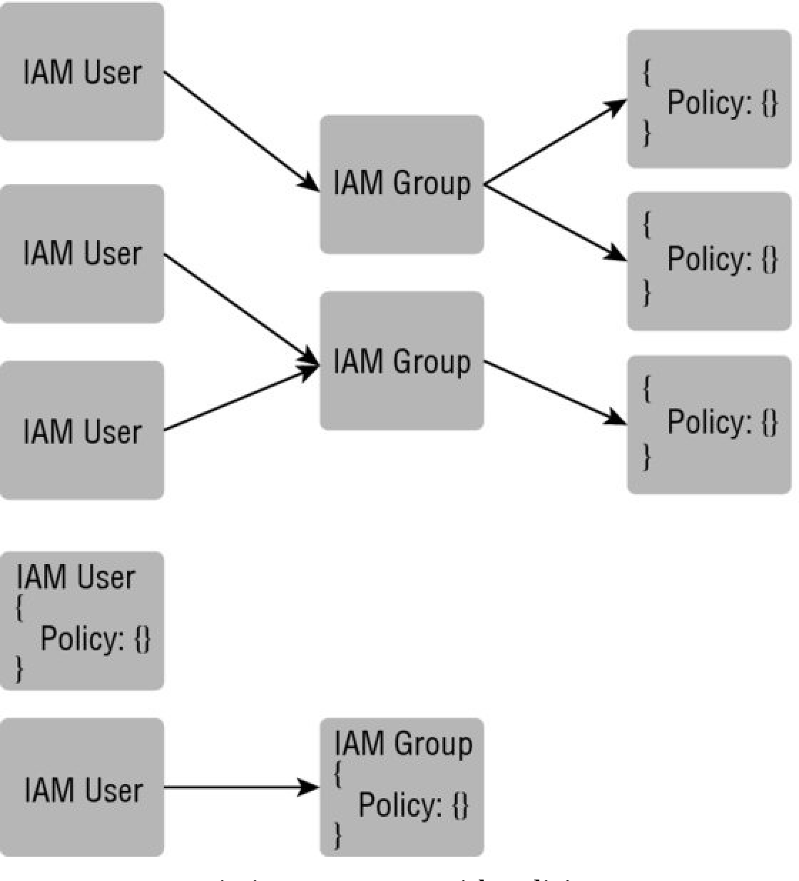
Authorization
Associating Policies with Principals
  User Policy
  Managed Policies
  Group Policy
  Managed Policies

Slide 11
Lesson 04: Other Key Features

Slide 12
Other Key Features
Multi-Factor Authentication (MFA)
Rotating Keys
Resolving Multiple Permissions

Slide 13
Lab Module 6

